Slide 1

Lecture
on
“Advanced Computer Architecture –TCS 704”
by
Akansha Gupta
DEPARTMENT OF COMPUTER SCIENCE AND ENGINEERING
GRAPHIC ERA DEEMED TO BE UNIVERSITY – 248002

Slide 2
Trends in Computer Architecture
Trends in Technology
– Performance: bandwidth vs. latency
– Transistor and wire scaling
• Trends in Power
• Trends in Cost
• Trends in Reliability

Slide 3
Trends in Technology
Technologies that impact architecture:
– Logic manufacturing technology
• Transistor Density: ~ 35% / yr
• Die size: ~ 10-20%
• # transistors per chip: ~ 40-55%
– Memory (DRAM) manufacturing technology
• Capacity ~ 40%
– Storage technology
• Magnetic disk density ~ 30% (since 2004)
– Network technology

Slide 4
Bandwidth vs. Latency
Bandwidth or throughput
– Total work done in a given time
– 10,000-25,000X improvement for processors
– 300-1200X improvement for memory and disks
• Latency or response time
– Time between start and completion of an event
– 30-80X improvement for processors
– 6-8X improvement for memory and disks

Slide 5
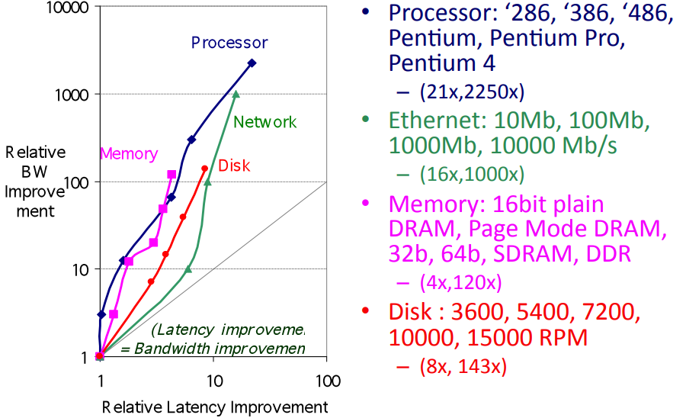
Bandwidth vs. Latency

Slide 6
Transistor and Wires Scaling
Wire delays do not scale well with technology
– Delay proportional to Resistance * Capacitance
– Wire lengths decrease with feature size reductions
– But, resistance and capacitance per unit length increase
• Poor wire delay scaling compared to transistor scaling creates design challenges
– Larger fractions of processor clock cycle consumed by signal propagation delay on wires

Slide 7
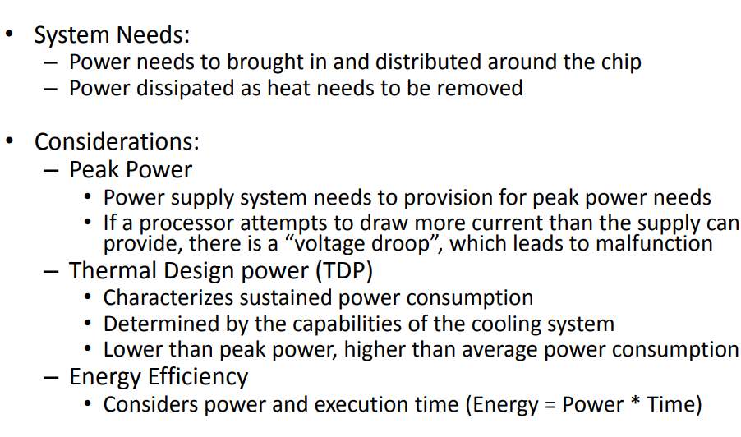
Power & Energy: A Systems Perspective

Slide 8
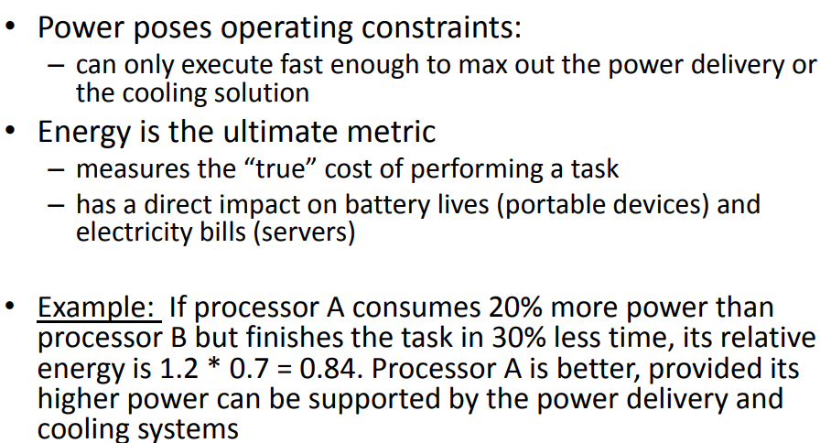
Power vs. Energy

Slide 9
Power vs. Energy
Reducing clock rate reduces power, not energy
Reducing voltage reduces both power and energy
– Voltages have dropped from 5V to < 1V in 20 years

Slide 10
Trends in IC Power
Total Power = Dynamic Power + Static Power
Dynamic (switching) power
– Power consumed charging and discharging capacitances in integrated circuits (ICs)
Static power
– Power dissipated when circuits aren’t switching
– Also called “leakage” power

Slide 11
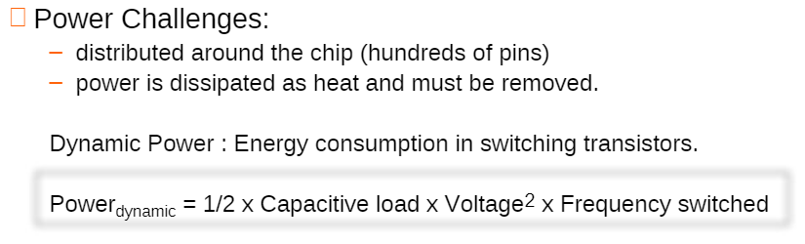
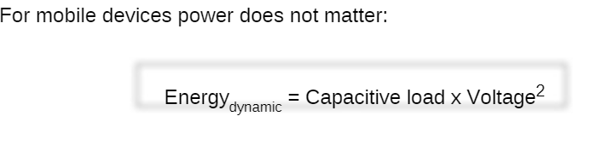
Dynamic Power

Slide 12
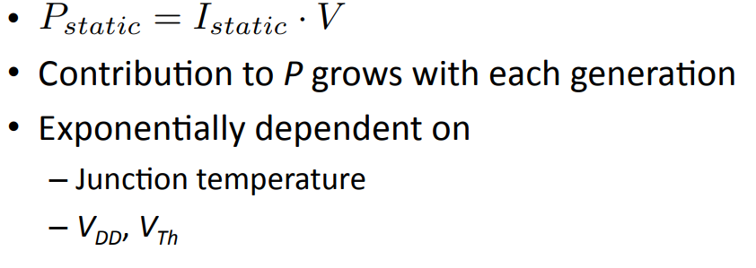
Static Power

Slide 13
Power Example
Many microprocessors have adjustable supply voltage. Suppose a 15% reduction in voltage results in a 15% reduction in frequency.
• What is the effect on dynamic power?

Slide 14
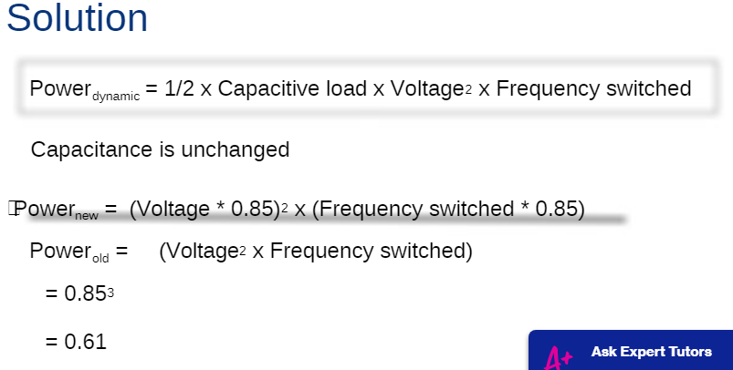
thereby reducing power to about 60% of the original.

Slide 15
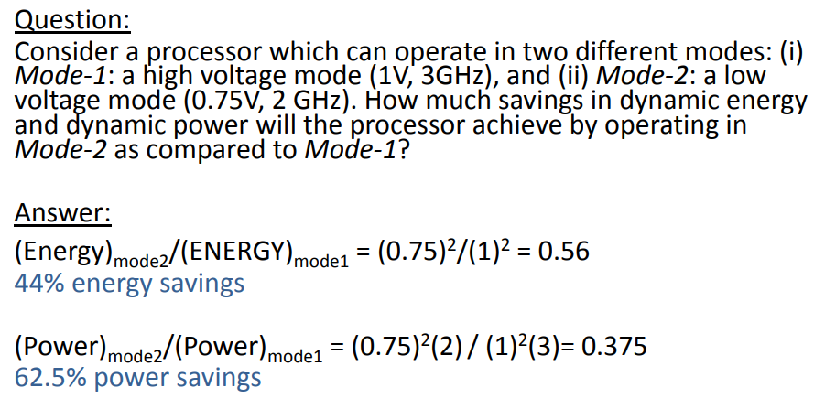
Example

Slide 16
https://youtu.be/bKmV6T10NLs
THANKS

